Slide 1
Big Mountain Resort
In an effort to increase revenue, Can big mountain identify if there is justification in a ticket price increase based on key features, which will also allow for a more calculated ticket price selection?
H
1
Context
4
Constraints within solution space
Big Mountain resort, a ski resort located in Montana, wants to take a closer look at their ticket price point as it is currently selected based on the average ticket prices of resorts in its market segment. This pricing scheme doesn’t now allow for data driven investment as they don’t have a clear idea of which of the importance of its facilities. They are considering cutting costs or providing support for a higher ticket price.
Potential constraint in not knowing how far back the data goes and if it contains any gaps in data
Potential constraint in knowing how many people have purchased tickets in the past
2
Criteria for success
5
Stakeholders to provide key insight
Identify if there is justification in marketing for lower wait times and longer ski experience and having a higher ticket price. If not, then a lower capex would need to be explored.
- Big Mountain managers and decision makers
3
Scope of solution space
6
Key data sources
Will focus only on the CSV file given
Single CSV that has information for Big Mountain and 330 other resorts in the US that are considered part of the same market share. Same data columns for all
H
D
E
I
P
Notes:
Hypothesis: Create a Hypothesis with an emphasis on SMART principles. (S – Specific, M – Measurable, A – Achievable, R – Realistic, T – Timebound). If you cannot do this, you do not have a good grasp on the business problem.
Context: With context, we have clearly identified the problem at hand and have elucidated on how our initiative may solve this problem, alongside the commercial implications this will have on the business.
Criteria for Success: Clearly defining the criteria for success ensures that the scope of your work is clearly defined and understood. Otherwise, if this isn’t defined – your work will never end which will result in mismatched expectations.
Scope of Solution Space: Scoping out the solution space ensures that the business initiative is SPECIFIC for a certain segment or area. This prevents solutions that have been developed being scaled and applied for all other business units that the solution may not be responsible or scalable for.
Constraints within Solution Space: Looking forward, what are the foreseeable problems we are likely to encounter? Could this be stakeholder resistance? Could this be we don’t have access to the right data?
Stakeholders to provide key insight: Who are the people I need to speak to, to get the answers I need for my data analysis?
What key data sources are required?
Based off my discussions with the key stakeholders – can we clearly list out all the data sources we need so we can make a highly targeted request as opposed to a scatter-gun approach where we ask for a bit of everything?

Slide 2
Recommendation
Current
Big Mountain currently charges $81 for weekend and weekday tickets.
Recommended Change
There is justification to increase ticket prices from $81 to $82.51 by increasing the number of runs by 1, vertical drop by 150 feet, and total chairs by 1. Assuming 5 tickets sold and 350,000 visitors per year, a potential increase of approximately $2.64 million revenue, which would the cover the expense of the additional chair.

Slide 3
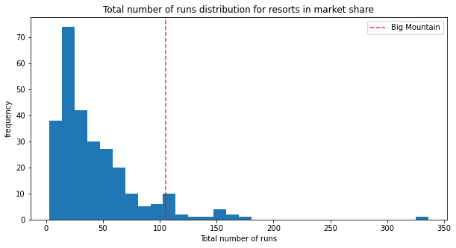
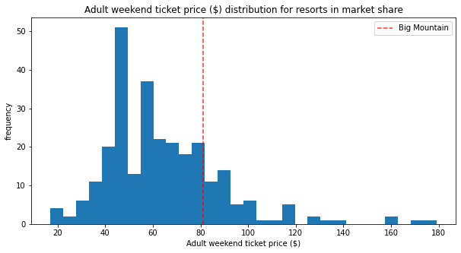
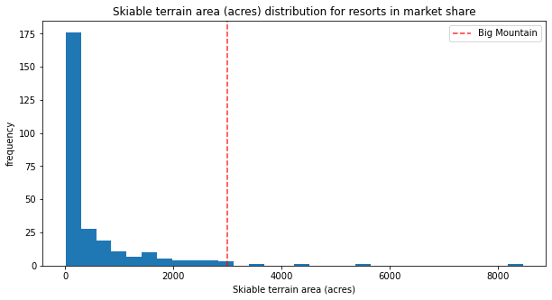
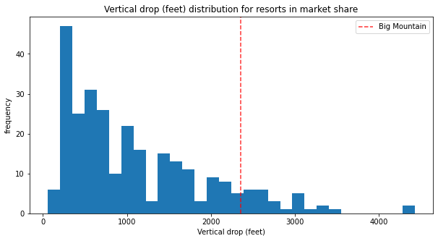
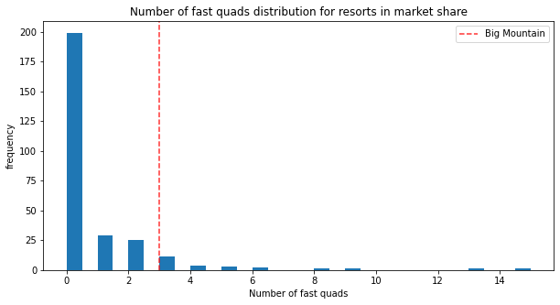
Modeling Results and Analysis
First a look at how Big Mountain compares with the competitors as it relates to the 4 most influential features as it relates to effect on price.
A random forest regression produced the lease variation and least error, so it was used to model the scenarios.
As can be seen with the stack of histograms on right, Big Mountain is in the upper parts of runs, skiable terrain, vertical drop, and fast quads. This give justification for a potential ticket increase, as the model will show.

Slide 4
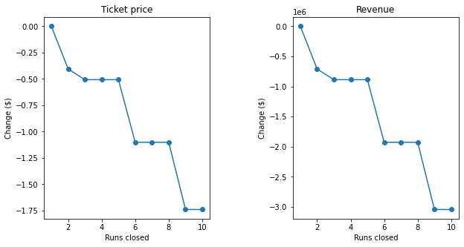
Modeling Results and Analysis
Scenario 1: Reducing the number of runs
Result: No affect on ticket prices with 1 run closed and a negative affect on prices with more than 1 run closed.

Slide 5
Modeling Results and Analysis
Scenario 2: Adding a run, increasing vertical drop by 150 feet, and installing an additional chair lift
Result: Support for a $1.51 increase in ticket prices that could lead to $2.6M revenue over the course of the year, assuming 5 tickets sold and 350,000 visitors.
Scenario 3: Same as Scenario 2 but adding 4 acres of snow making
Result: No change in support for $1.51. Adding such a small amount would not make a difference.
Scenario 4: Increasing longest run by 0.2 miles and adding 4 acres of snow making capability
Result: No change from the baseline of the current setup. This would have no support for a change in current price under the current model.

Slide 6
Summary and Conclusion
Proceed with Scenario 2 as there is justification to increase ticket prices from $81 to $82.51 by increasing the number of runs by 1, vertical drop by 150 feet, and total chairs by 1. Assuming 5 tickets sold and 350,000 visitors per year, a potential increase of approximately $2.64 million revenue, which would the cover the expense of the additional chair.
Changing length of the longest run or acres of snow making capability does not appear to provide positive support for a change in price in the current model, so leave these features as they are.

